Slide 1


Effects of Sub-Atmospheric Pressures on the Temperature Evolution of Spark Kernels
Daniel Caplan and David Blunck, PhD.
SciTech, 8-12 January 2018
Kissimmee, Florida
GTE-07, Control ID 2795470

Slide 2
Introduction
Studying how subatmos pressure affects
the temperature
Fluid mechanics
Other characteristics

Slide 3
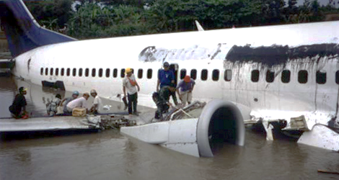
Why Study Low Pressure Ignition?
High altitude re-ignition
Afterburner ignition
Garuda Indonesia Flight GA421 wreckage after dual engine flameout induced by inclement weather [1]

Slide 4
How is Ignition Studied?
4

Slide 5
Numerical Modeling

Slide 6
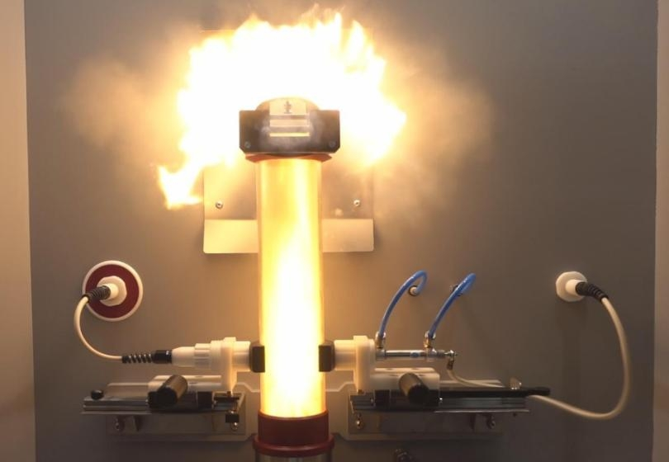
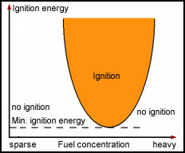
Minimum Ignition Energy (MIE)
Caption [x]
Caption [x]

Slide 7
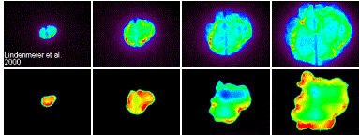
Spark Kernels: Reacting
Chemiluminescence
OH* LIF
Caption [x]

Slide 8
Spark Kernels: Non-Reacting

Slide 9
The Experiment
9

Slide 10
Goals
How sub-atmospheric pressure affects
temperature
fluid mechanics
other characteristics

Slide 11
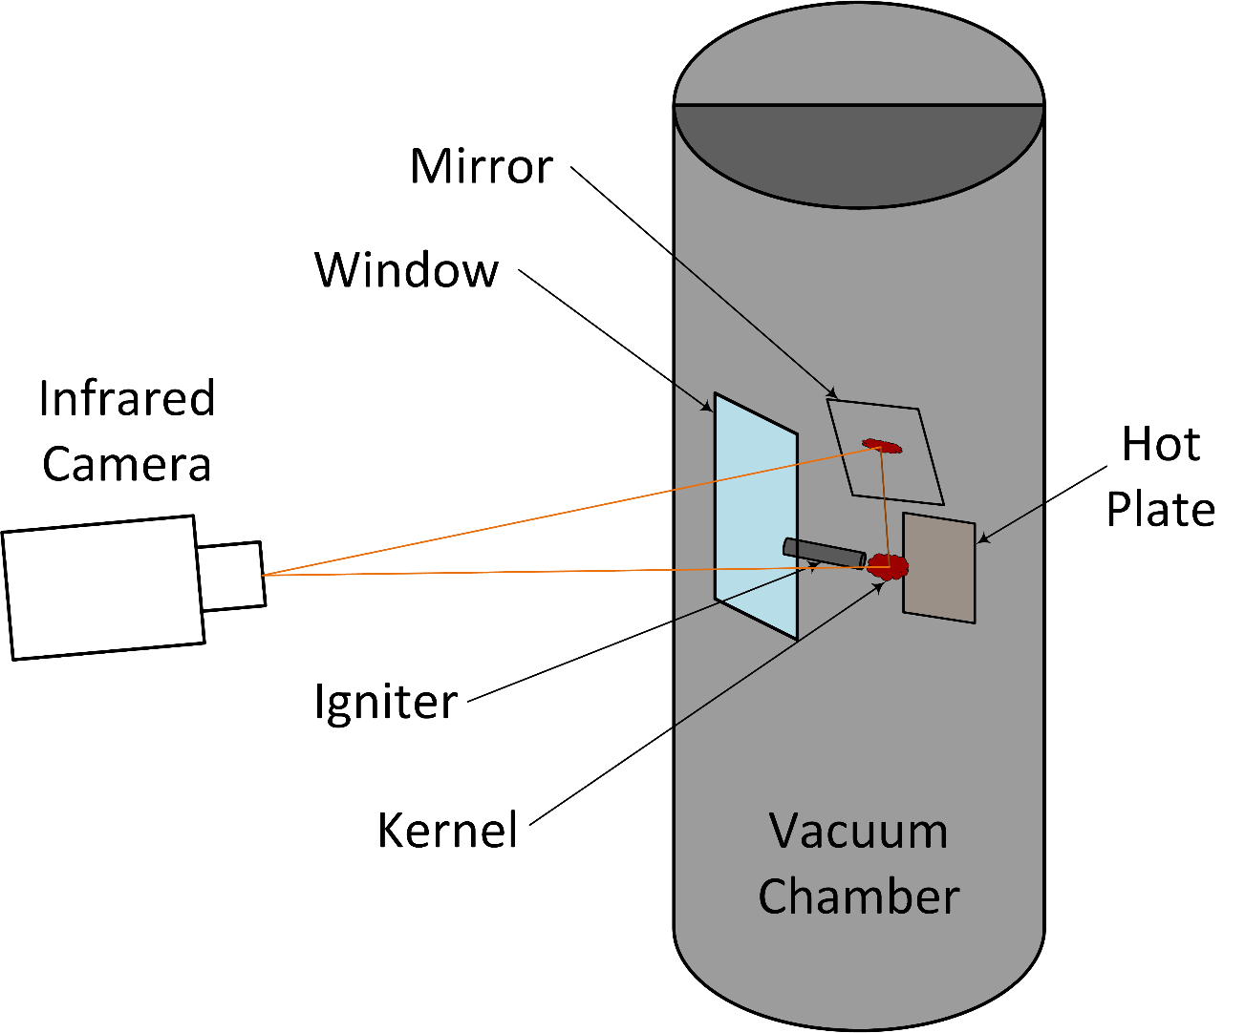
Experimental Setup
Ejectors
Replace with Solidworks model
Gas Analyzer

Slide 12
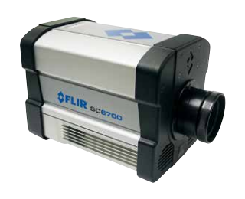
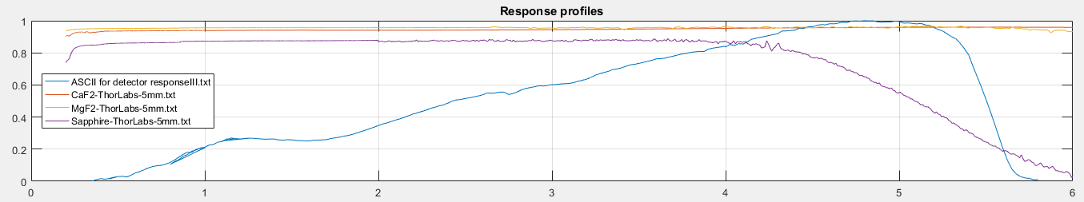
Data Collection
Camera: FLIR SC6700
MWIR InSb Detector, 1-5 μm
Blackbody calibrated
~1500 Hz
Window: Sapphire
IR Transparent
Cost Effective
Strong
Window transmission and Kernel emissions spectra [x,x]

Slide 13
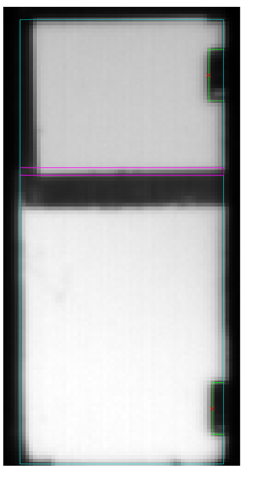
Experimental Setup
Photo of chamber with igniter inside
Animate with video

